Slide 1
Getting Information from a
GIS map

Slide 2
Attributes
Features have attributes.
An attribute is a piece of information that identifies what a feature is, describes the feature, or represents some magnitude associated with the feature.
A GIS layer may include many or only a feature attributes.

Slide 3
Attributes
Features have attributes.
An attribute is a piece of information that identifies what a feature is, describes the feature, or represents some magnitude associated with the feature.
A GIS layer may include many or only a feature attributes.

Slide 4
Attributes tables
Tables contain rows.
All rows (records) in a table have the same fields.
Each column (field) has a data type such as integer, decimal number, character, and date.
Functions and operator available to manage tables.

Slide 5
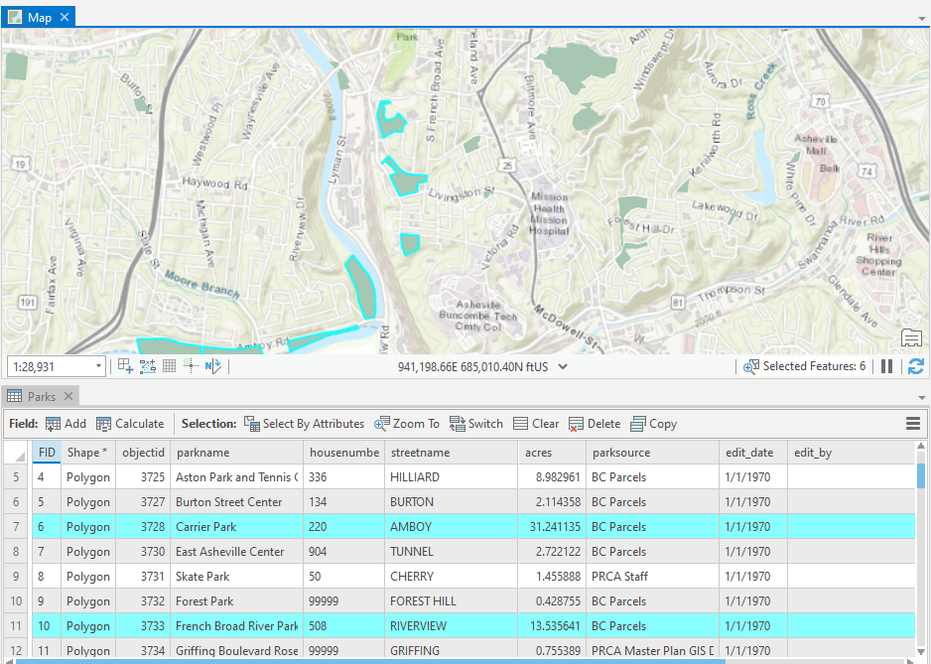
Attribute table and associated features

Slide 6
Types of Tables
Feature classes store spatial information.
Rows store all the properties of geographic objects.
Manages feature geometry in a Shape column.
Stand-alone tables do not store spatial information.
Stand-alone tables store additional information that may be related to a layer of spatial information.
Consider the tax parcel layer (feature class) managed by the GIS department and the property owner database (table) managed by the tax assessor's office.

Slide 7
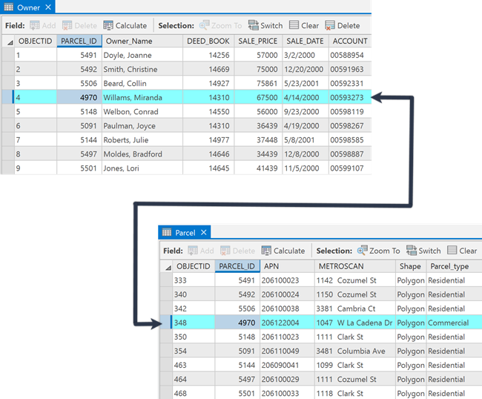
Table
relationships
Tables can be related (joined) by a common field with the same attribute values.

Slide 8
System Fields
System fields - When a feature class or table is created, several system fields are created.
System fields allow the software (system) to perform certain management tasks.
Examples:
OBJECTID
SHAPE
Shape_Area
System fields will vary based on data format.
System fields cannot be modified by the user.

Slide 9
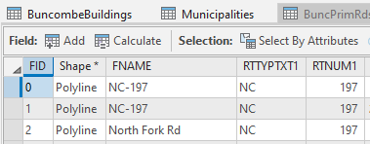
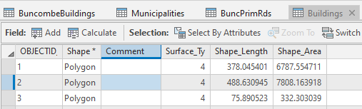
System Fields
System fields vary based on GIS data format.
Shapefile
FID
Shape
Geodatabase FC
OBJECTID
Shape
Shape_Length
Shape_Area
System
User
System
System
User
User

Slide 10
User Fields
User fields are created by the user.
How do you decide what fields?
Careful consideration and database design
What will the data be used for?
How will it be used?
Sidewalk inventory example
Condition
Material
Populated, modified, and managed by the user.

Slide 11
System Fields
System fields vary based on GIS data format.
Shapefile
FID
Shape
Geodatabase FC
OBJECTID
Shape
Shape_Lenght
Shape_Area
System
User
System
System
User
User

Slide 12
What are those user-defined fields?
Why aren’t there other useful fields?
GIS data acquired online or from other places often have fields that are hard to interpret.
They meant something to the person that created them.
They are useful based on the original intent of the data.
Tables can be updated with new fields for new purposes.

Slide 13
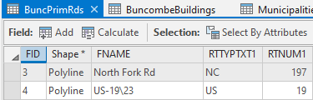
What are those user-defined fields?
RTTYPTXT1
Explore values
Explore metadata
Ask someone?
You may never know … and you may not care.

Slide 14
Data Types (field types)
Numbers
Short / Long integer
Float / Double
Text (string)
Dates
BLOBS (Binary Large Objects) - storing annotation / dimensions
https://desktop.arcgis.com/en/arcmap/latest/manage-data/geodatabases/arcgis-field-data-types.htm

Slide 15
Number Data Types (field types)
Data type | Storable range | Size (Bytes) | Applications
Short integer | -32,768 to 32,767 | 2 | Numeric values without fractional values within specific range; coded values
Long integer | -2,147,483,648 to 2,147,483,647 | 4 | Numeric values without fractional values within specific range
Float (single-precision floating-point number) | approximately -3.4E38 to 1.2E38 | 4 | Numeric values with fractional values within specific range
Double (double-precision floating-point number) | approximately -2.2E308 to 1.8E308 | 8 | Numeric values with fractional values within specific range

Slide 16
Data Types (field types)
Numbers can be stored in a text field. No math can be performed.
Building number (600 or 600B)
Route number
Text cannot be stored in number fields.

Slide 17
Attributes and Symbology
When first added to a map, a features in a layer have the same symbol.
Features can be symbolized by qualitative or quantitative attributes.
Each has different properties that can be modified.

Slide 18
Attributes and Symbology
When first added to a map, a features in a layer have the same symbol.
Features can be symbolized by qualitative or quantitative attributes.
Each has different properties that can be modified.

Slide 19
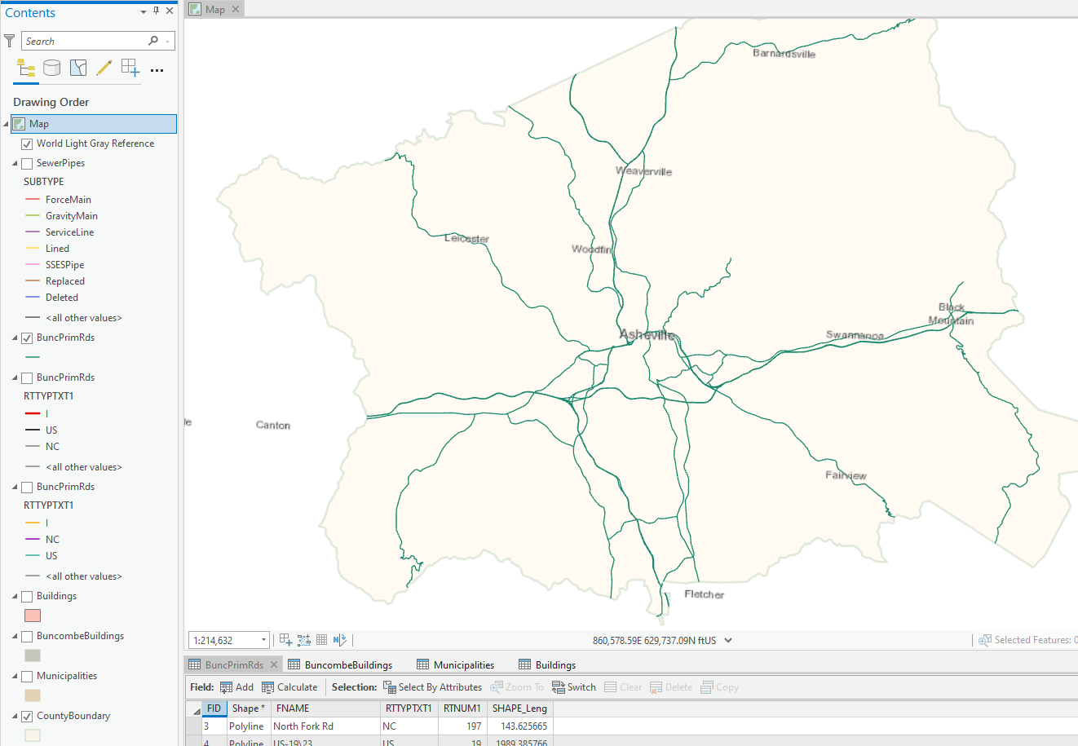
Qualitative data types - default same symbol

Slide 20
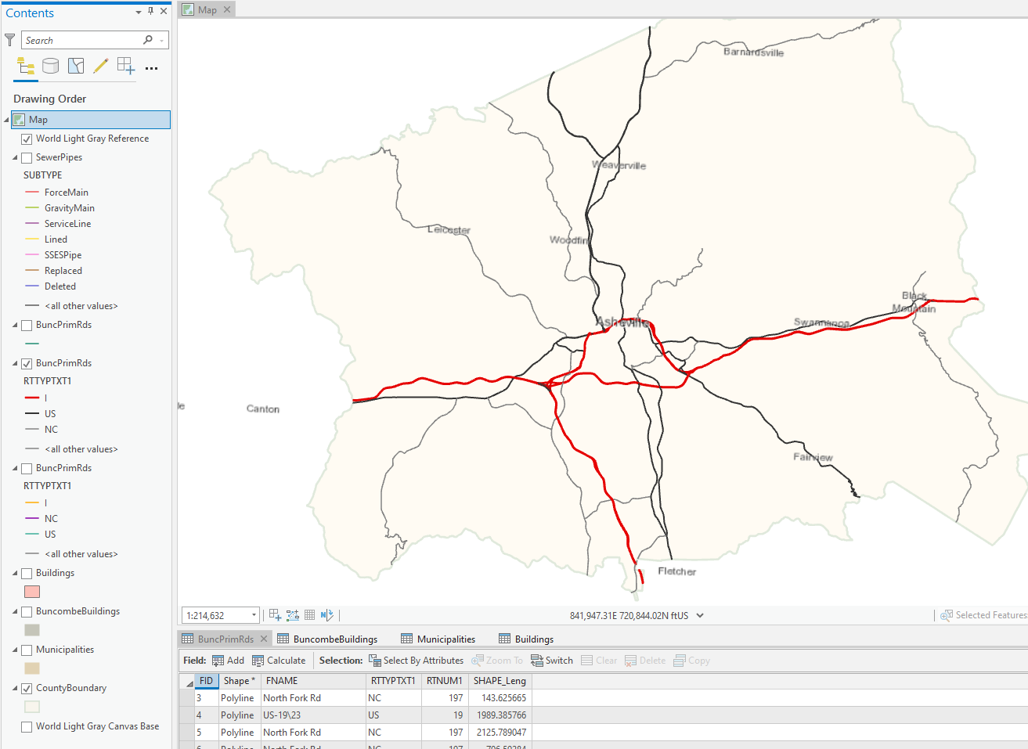
Qualitative data types - unique values

Slide 21
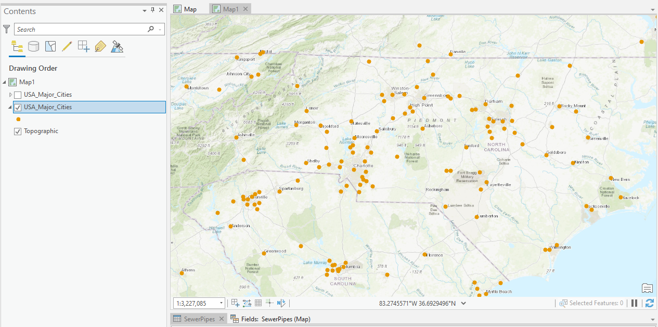
Quantitative data types - default same size

Slide 22
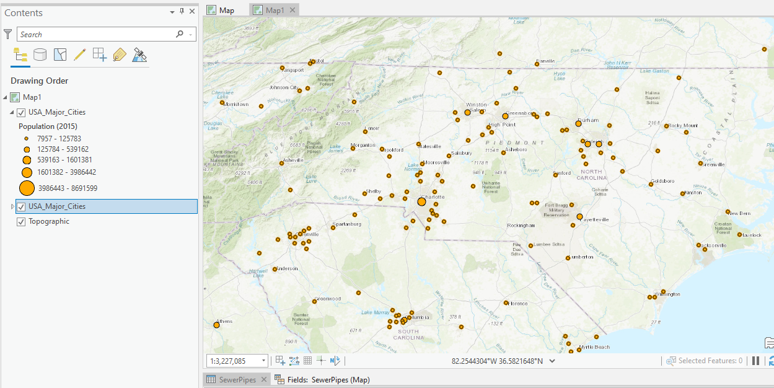
Quantitative data types - graduated sizes

Slide 23
Table Operations
Sort
Sum
Statistics
Calculate values
More ...

